Slide 1

Updated from the original presentation @ The 109TH ANNUAL MEETING ARRS BOSTON (2009)
3-Dimensional Doppler Sonography
and DCE-MRI of Recurrent Prostate
Cancer Following HIFU Therapy
ROBERT L. BARD, MD
Director - Biofoundation For Angiogenesis / New York, NY USA
JELLE O. BARENTSZ, MD
Vice Chair of Radiology Research / UMC St Raboud, The Netherlands

Slide 2
Objectives
Demonstrate image guided treatment by HIFU
Demonstrate tumor recurrence by imaging
Neovascularity with Doppler US and DCE-MRI
Document tumor response as vascularity alteration

Slide 3
PSA - New Status
Past predictor of cancer
Currently predicts bph
Post surgical marker
Rise after treatment signifies possible tumor
recurrence in prostate or elsewhere
Stamey t et al
Journal of urology 2004

Slide 4
Imagerie de L’angiogenesis
UTILISER LES SEULS CRITERES DE DIMENSION TUMORALE LORS DU SUIVI DES TRAITEMENTS ANTI-ANGIOGENEQUES EST INAPPROPRIE
(tumor may enlarge as it is successfully treated due to the presence of cystic internal necrosis)
GUIBAL A, LUCIDARME O
Journees Francaises de Radiologie 2008
Dr. Lucidarme developed contrast enhanced ultrasound (CEUS) in 1999
CEUS VISUALIZES CAPILLARY BED

Slide 5
Materials and Methods
Prospective study
36 months 3D / Doppler / DCE-MRI
959 Patients Age 33-94 Gl 3-5
79 HIFU Treatments - 4 Repeat
3D Imaging 1.5 T MRI + Ftp DCE-MRI
Scans within 1 week timeframe
Follow up scan 3-6 months
18 Failures PSA + vascularity + BX
Doppler and DCE-MRI 89% Accuracy

Slide 6
HIFU - Non Invasive Rx
High intensity focus ultrasound
Treatment 1 hour per 20cc
Return to work immediately
Best for volume < 40 cc
Incontinence 3%
Erectile dysfunction 8%
Treats disease outside capsule
Treats proximal seminal vesicle
Kim c am jl radiology 2008

Slide 7
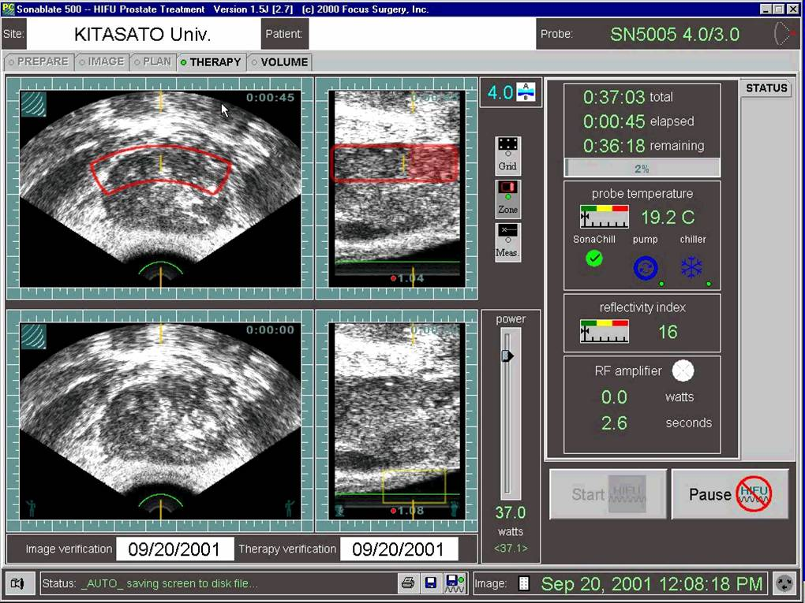
HIFU Treatment Protocol 20CC/Hour

Slide 8
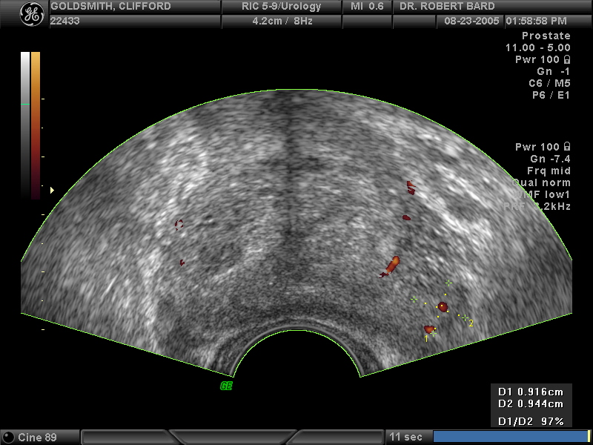
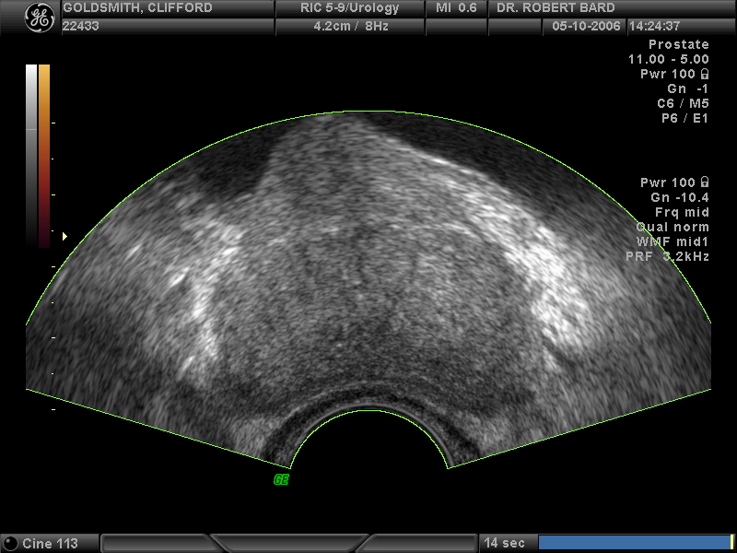
5 yr GL3 New L Base GL 4
Note post HIFU decrease in left vascularity
8/05 STUDY 12/05 HIFU 5/06 STUDY

Slide 9
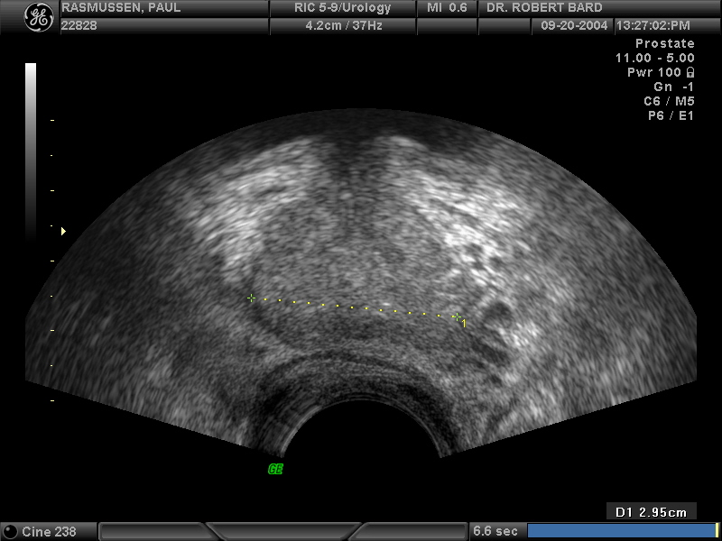
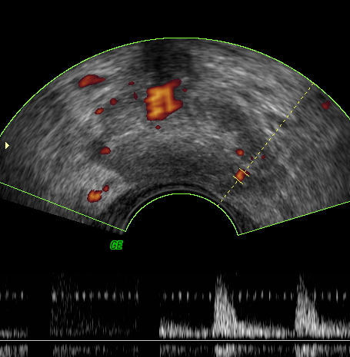
Post HIFU Recurrence
1/06 4/06
GL 5 HIFU Treated New Extracapsular Tumor

Slide 10
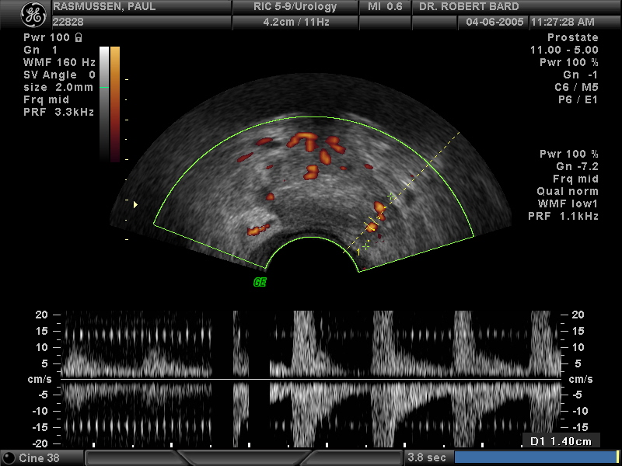
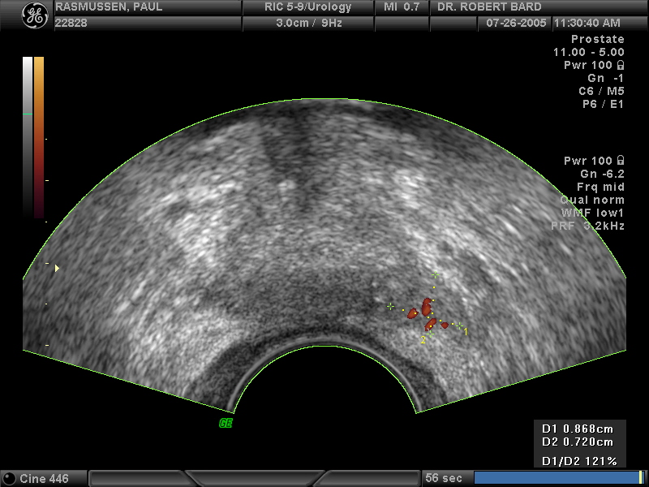
Post HIFU Re-recurrence
4/06 7/06
PERICAPSULAR TUMOR VESSELS AFTER 2ND HIFU

Slide 11
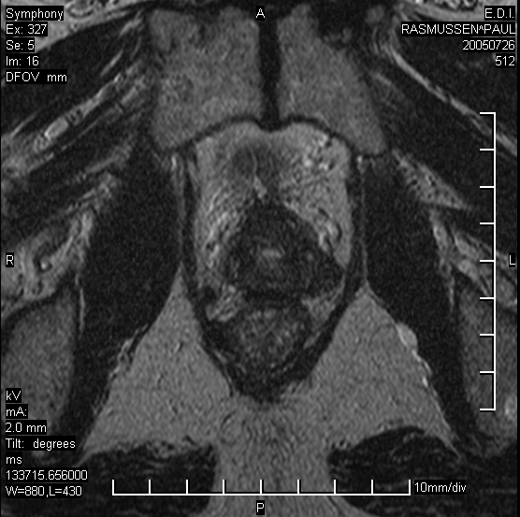
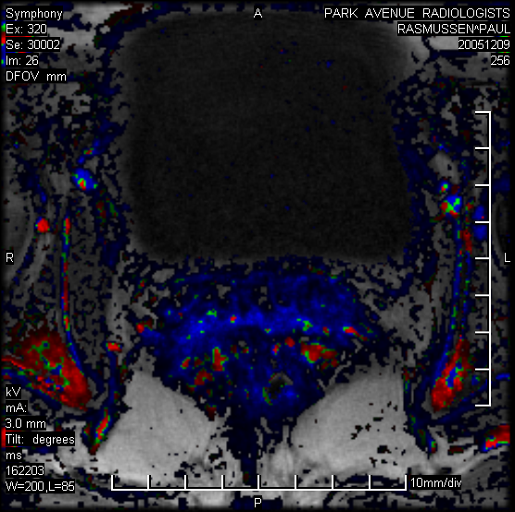
DCE MRI HIFU Recurrence
RASMUSSEN
Same patient as in last slide GL 5 2ND HIFU

Slide 12
Vascular Regression
HIFU-IMMEDIATE
RFA-IMMEDIATE
CRYOSURGERY-IMMEDIATE
ANTIOXIDANT 1-4 MONTHS
HORMONES 1-9 MONTHS
RADIATION 2-6 MONTHS
IRREVERSIBLE ELECTROPORATION
(under study since June 2008)

Slide 13
Post therapy- avascular extracapsular disease

Slide 14
Recurrence- seminal vesicle invasion and perirectal node

Slide 15
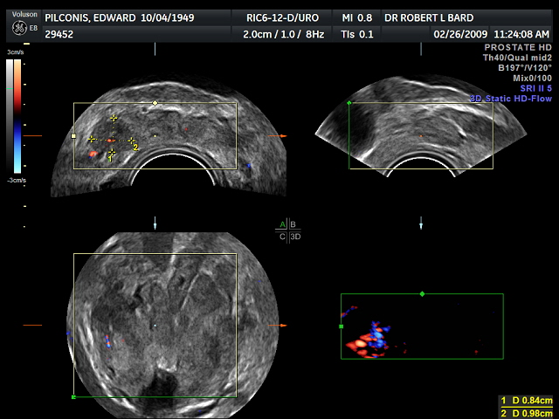
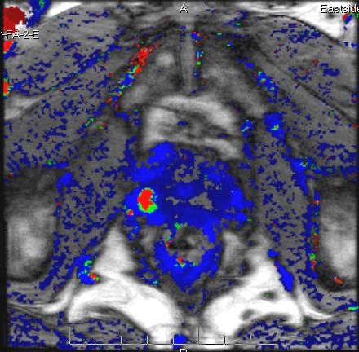
Post HIFU 2yr for LEFT GL3
New GL4 right base noted

Slide 16
Recurrent Gleason 5 with right inferior pubic ramus disease

Slide 17
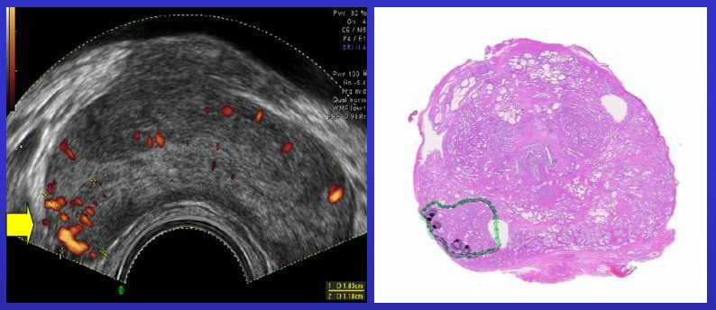
Tumor invades into but not beyond capsule
(Yellow right arrow denotes prostate capsule)
Green=GL 5,6 Black=GL 7,8,9

Slide 18
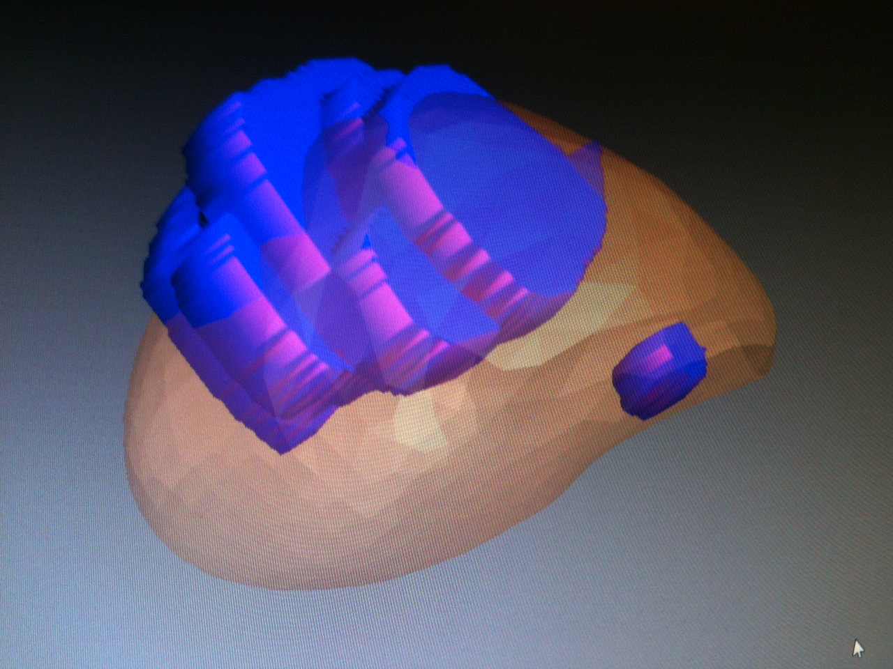
2011-Boston-Biopsy core missed Gleason 8-Fusion Rx

Slide 19
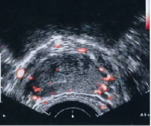
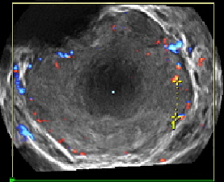
Comparison of 2D Color Doppler with
3D Power Doppler
2D Color Doppler 3D Power Doppler
Right base tumor palpable
▪ 2D shows right capsule erosion as loss of
white circumferential line (arrow)
▪ 3D shows left non-palpable lesion 9mm
(double arrows)

Slide 20
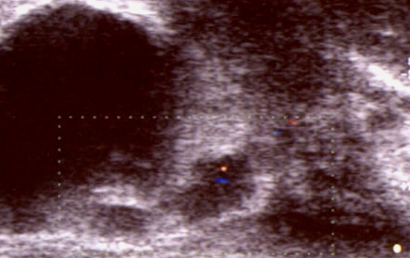
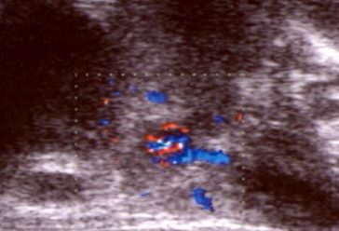
Contrast enhanced study of the postop prostate bed
* Note the increased flow with vascular pedicle near base
* Note the neovascularity demonstrated only with CEUS
Courtesy drs. V.Cantisani & F.Drudi “La Sapienza” Rome, Italy
Contrast CEUS not FDA approved in USA – developed 1996

Slide 21
Male Breast: Indications for Imaging
Do we ever do screening mammograms?
  Usually not, incidence too low to justify
  Possible exceptions, no set guidelines:
    BRCA positive
    Klinefelter’s syndrome
    Contralateral breast carcinoma
Some advocate screening mammogram annually at 50
Risk not high enough to warrant MRI screening
Strachowski, L. Breast Imaging of Males and Transgenders. Who, How, When (and Why?). UCSF CME presentation 2012.

Slide 22
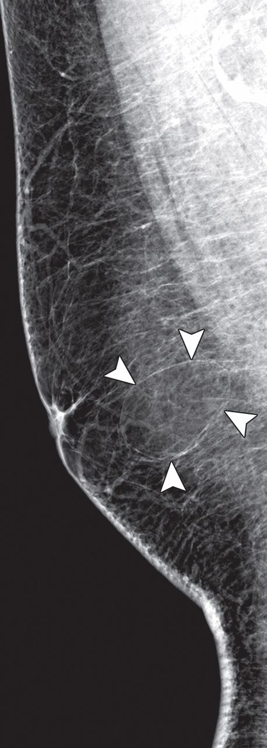
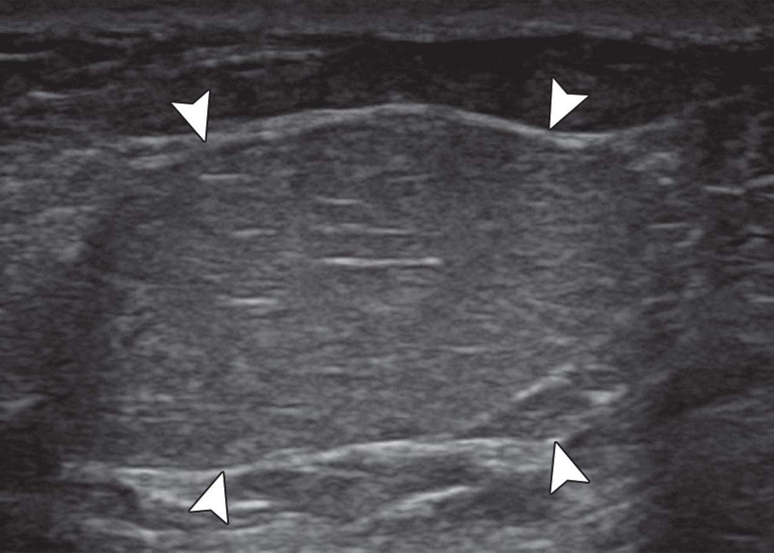
Lipoma
Oval fatty mass with
thin radiopaque
capsule
Oval parallel homogeneous isoechoic to hypoechoic mass with linear echogenic capsule
Lattin G E et al. Radiographics 2013;33:461-489

Slide 23
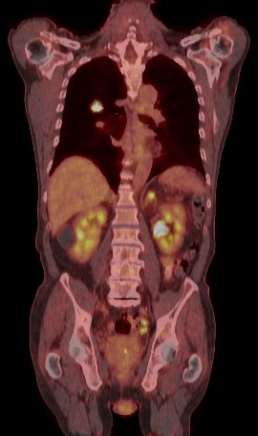
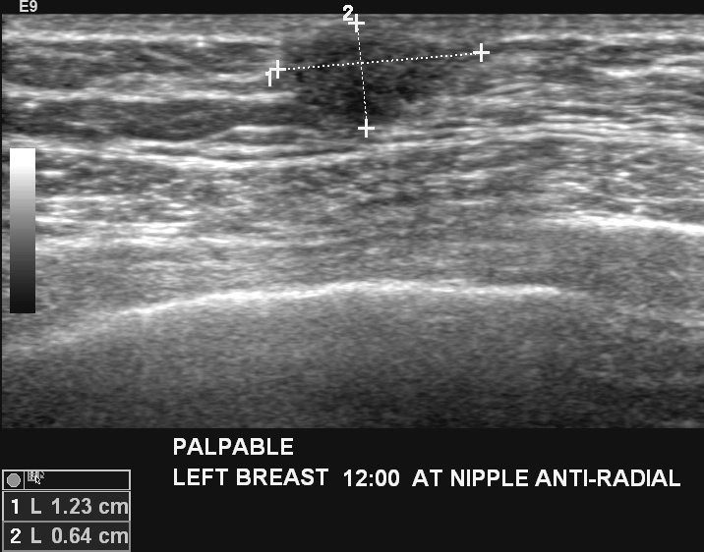
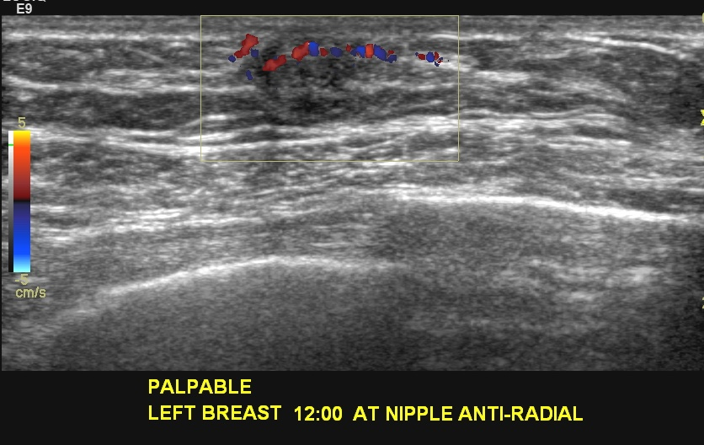
Invasive Ductal Carcinoma

Slide 24
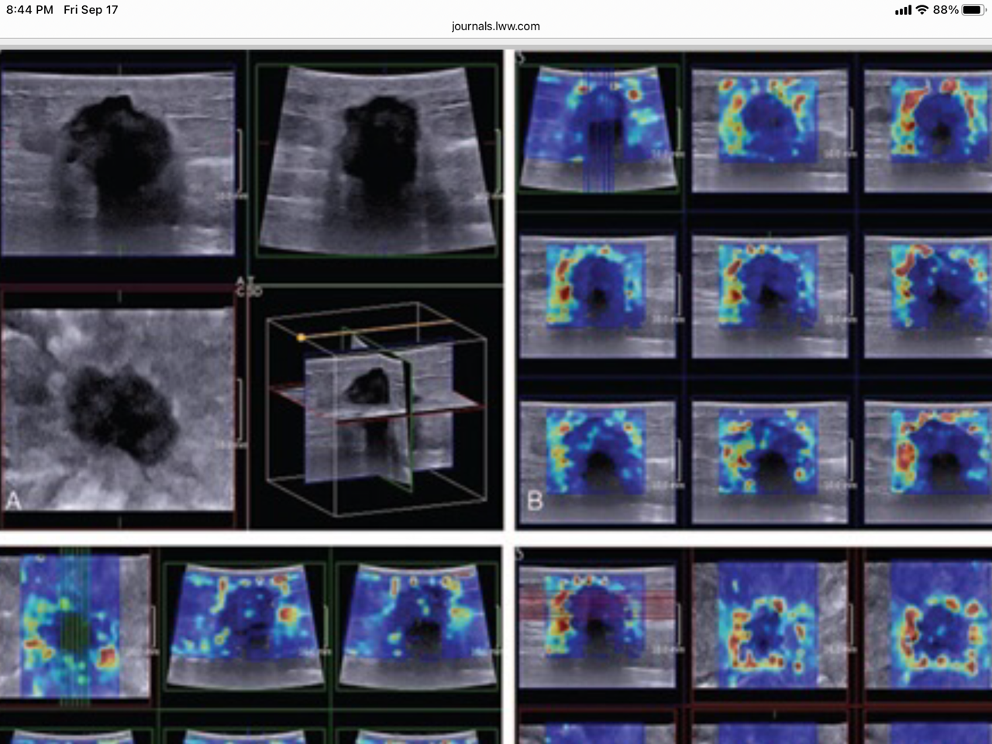
Crater Sign-3D Elastography

Slide 25
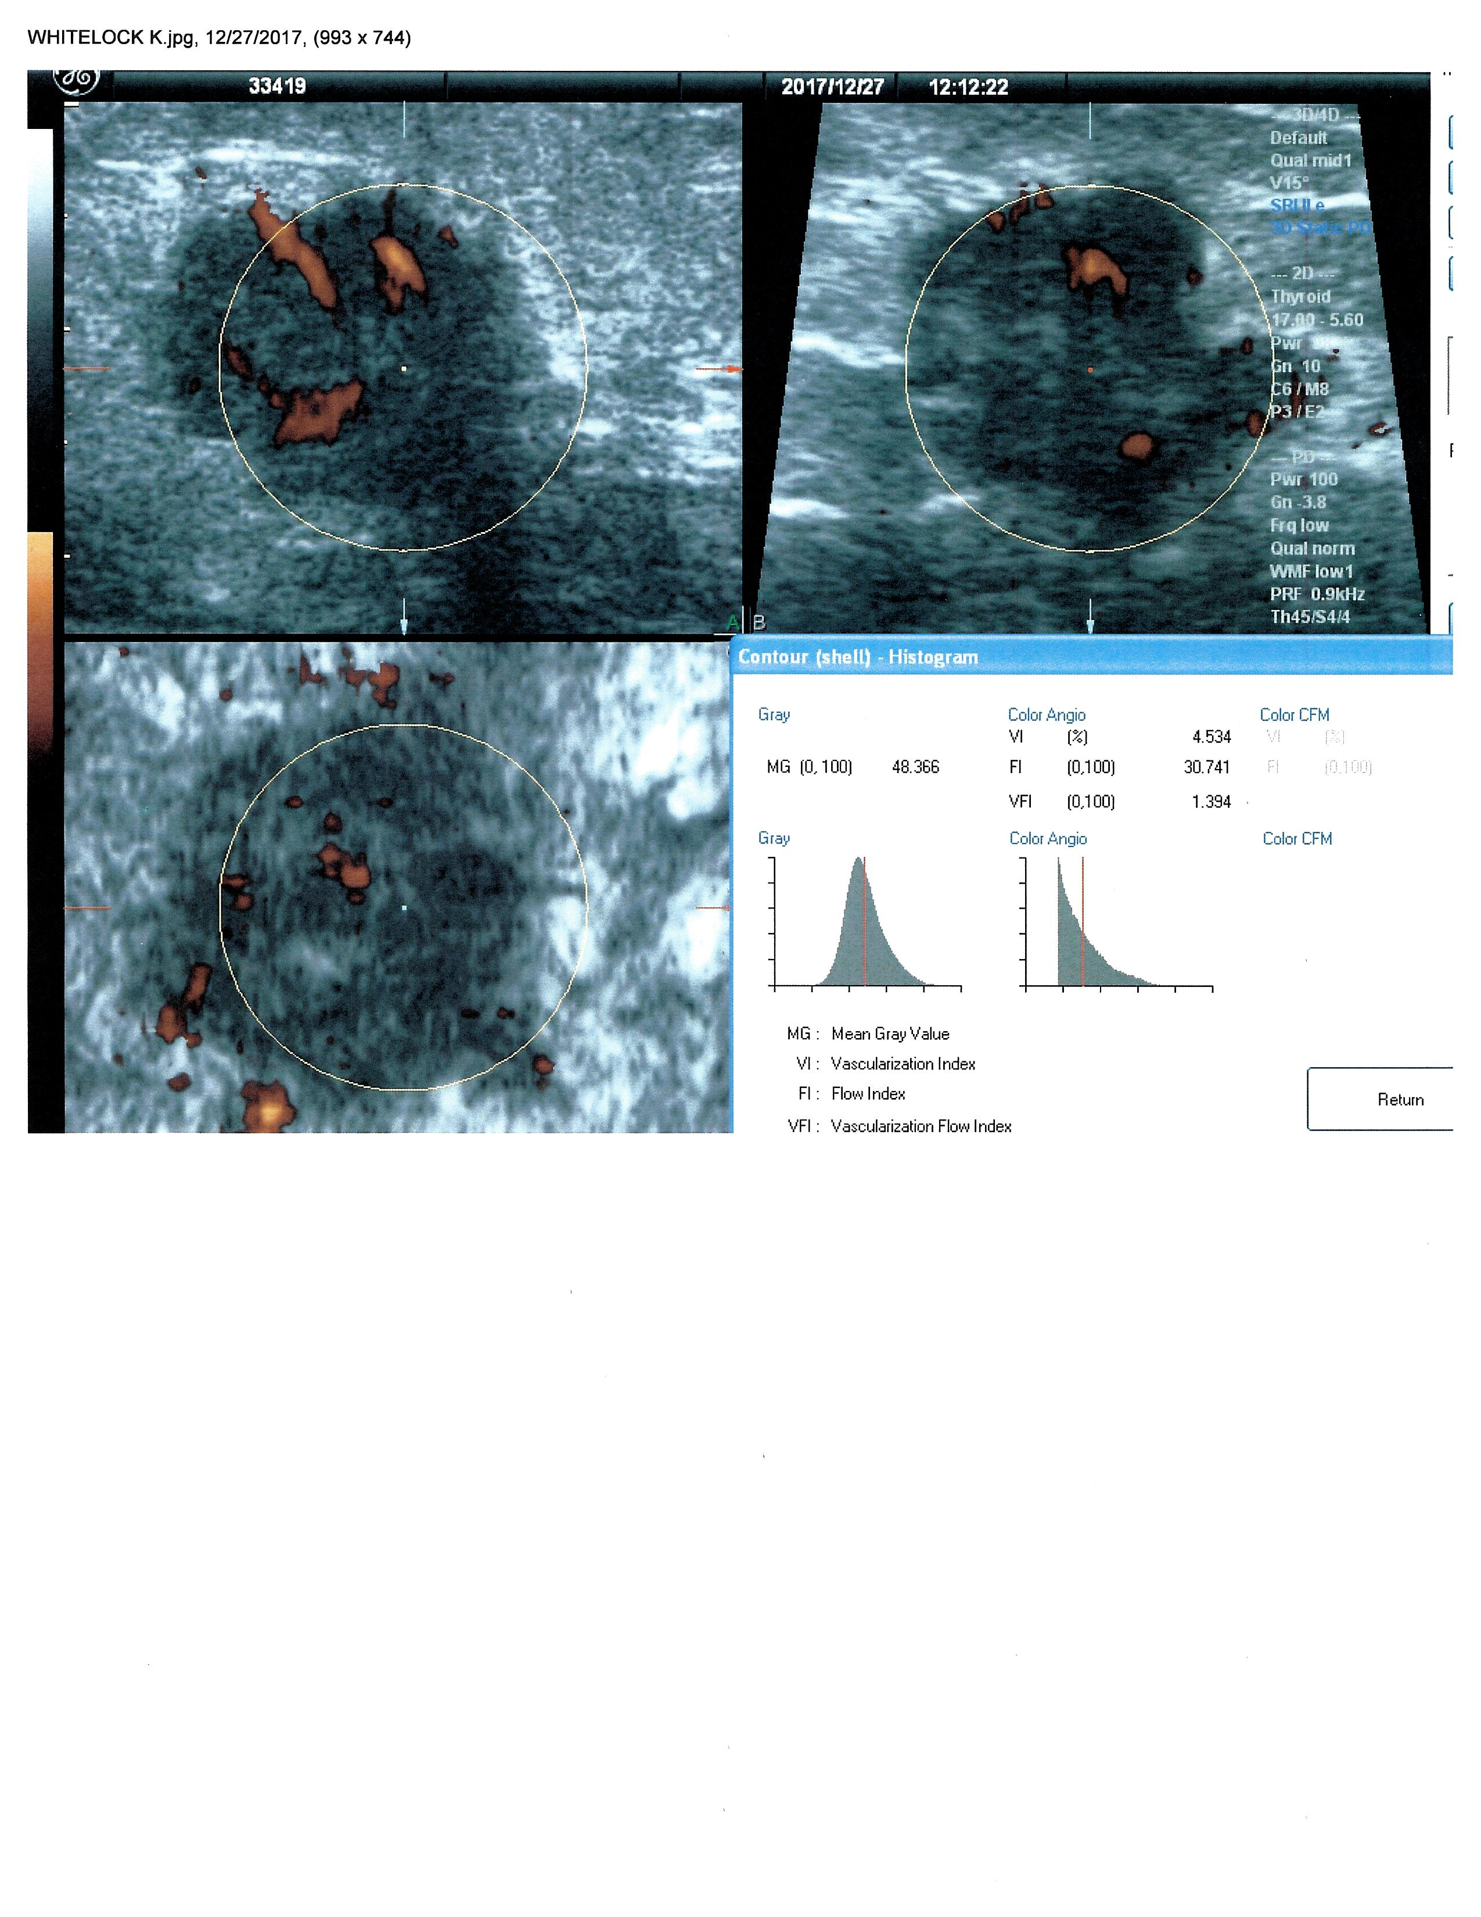
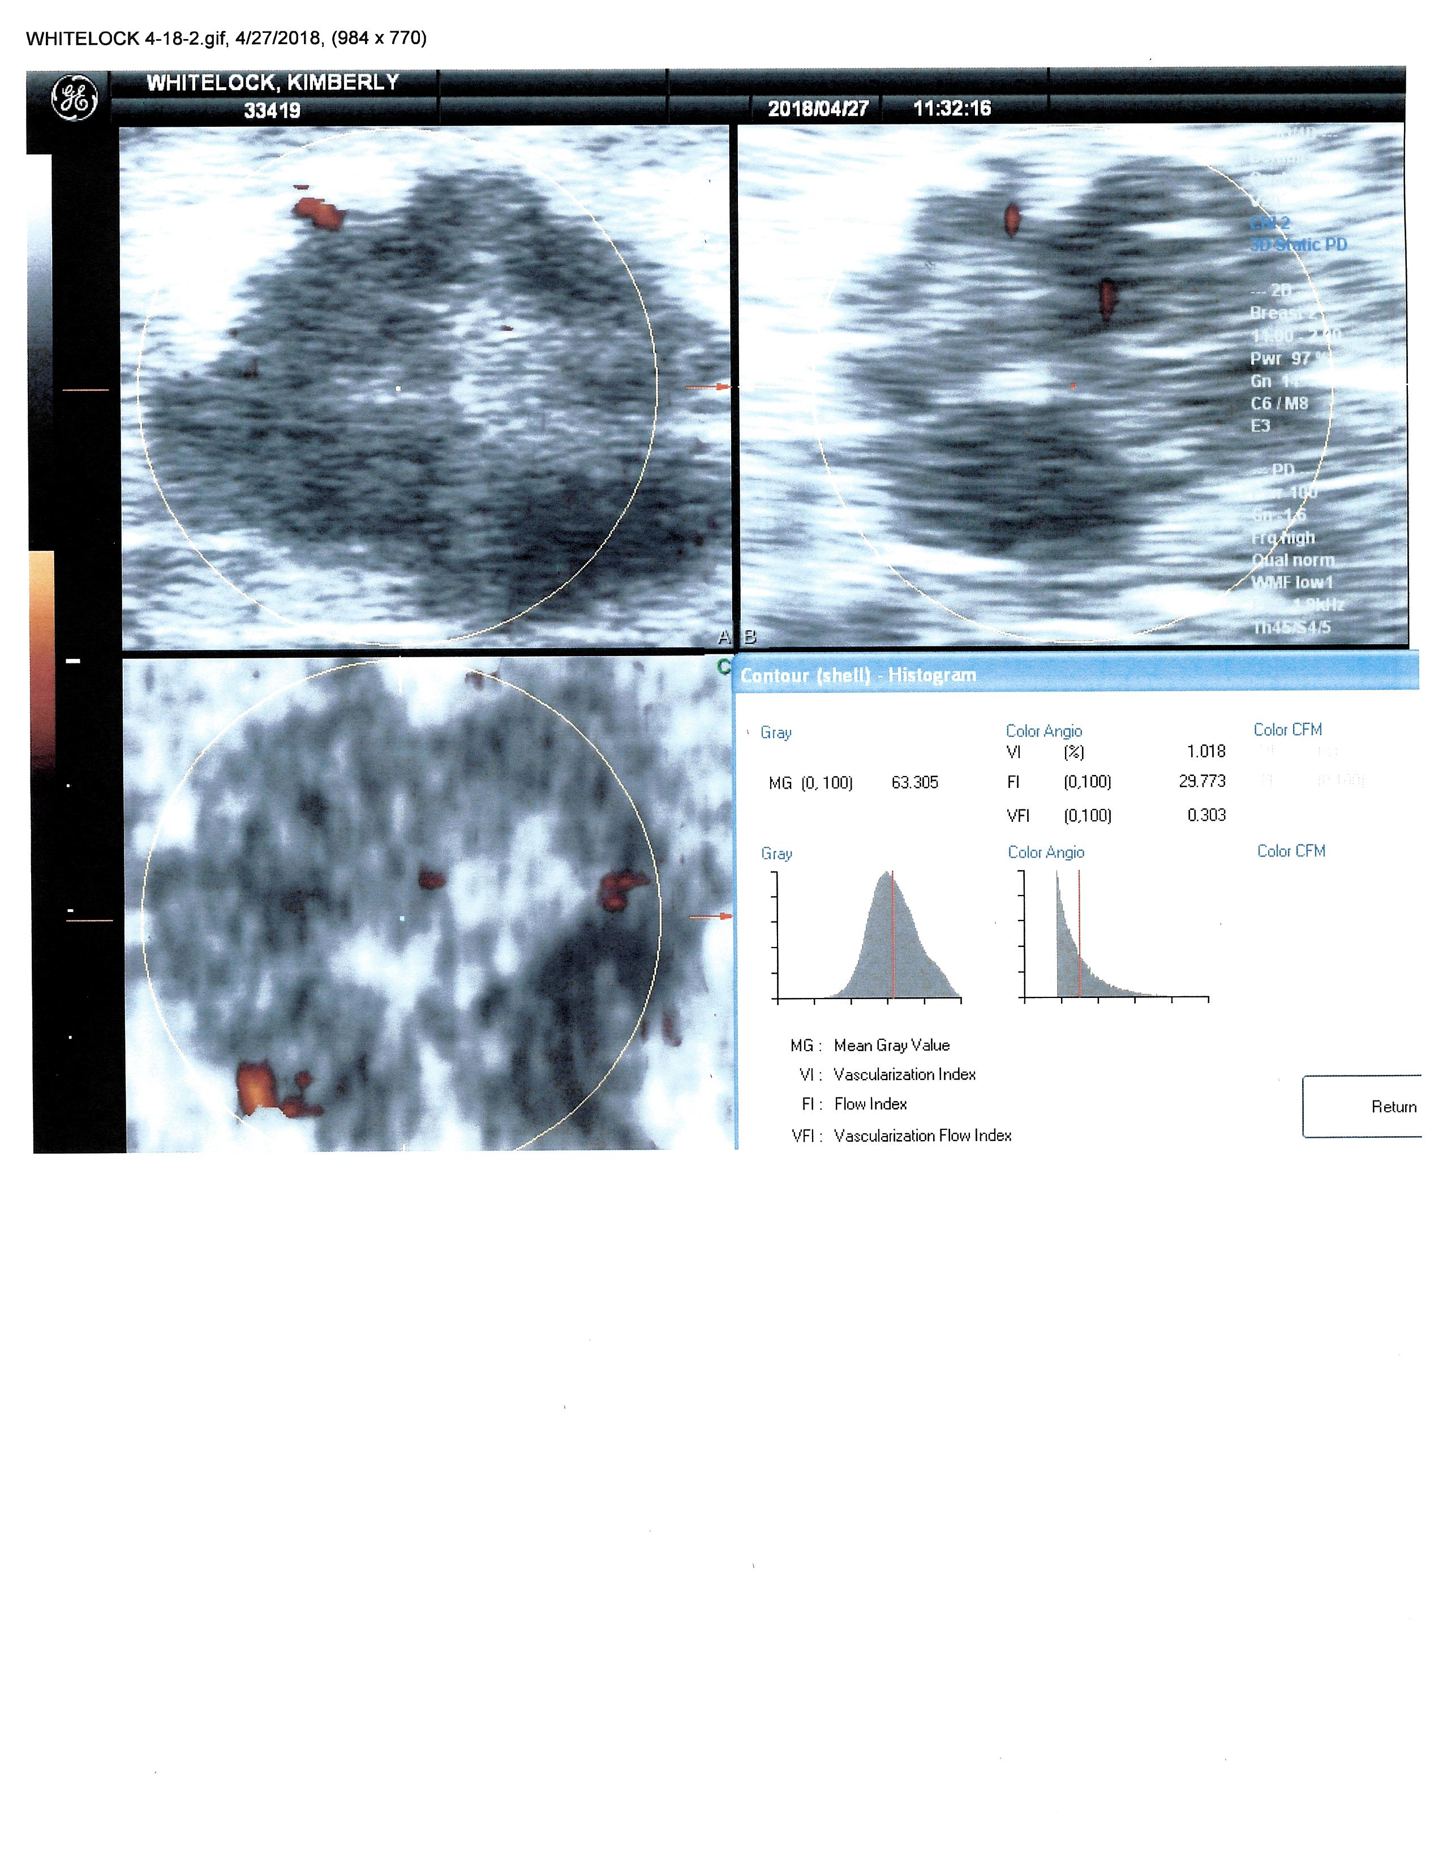
Rx Success-Breast Cancer
12/17 vi=4.5% 4/18 vi=1.0%

Slide 26
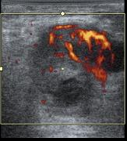
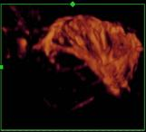
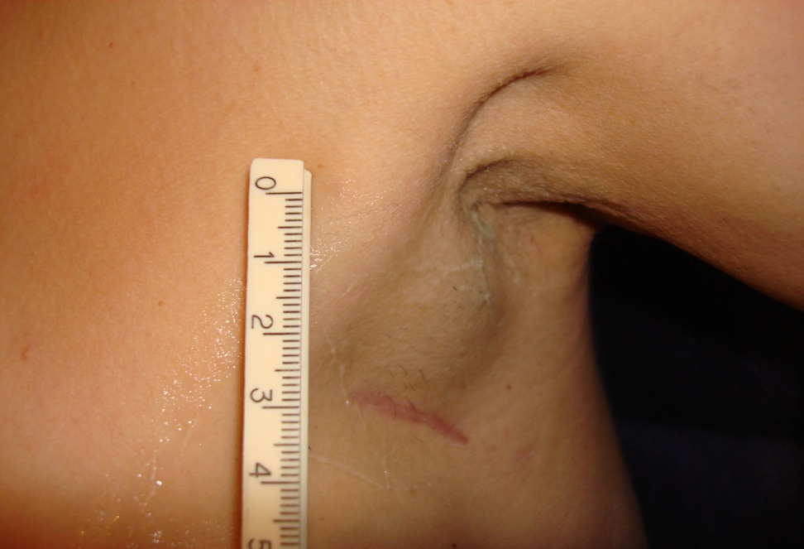
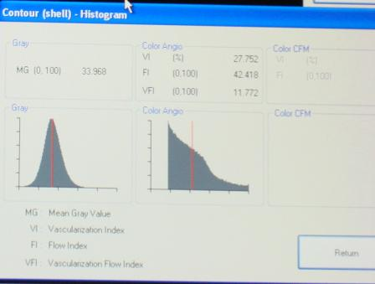
Biopsy Axillary Node
Avoid 8 Cc Necrotic Area
VESSEL
DENSITY
27%
VESSEL DENSITY 1 %

Slide 27
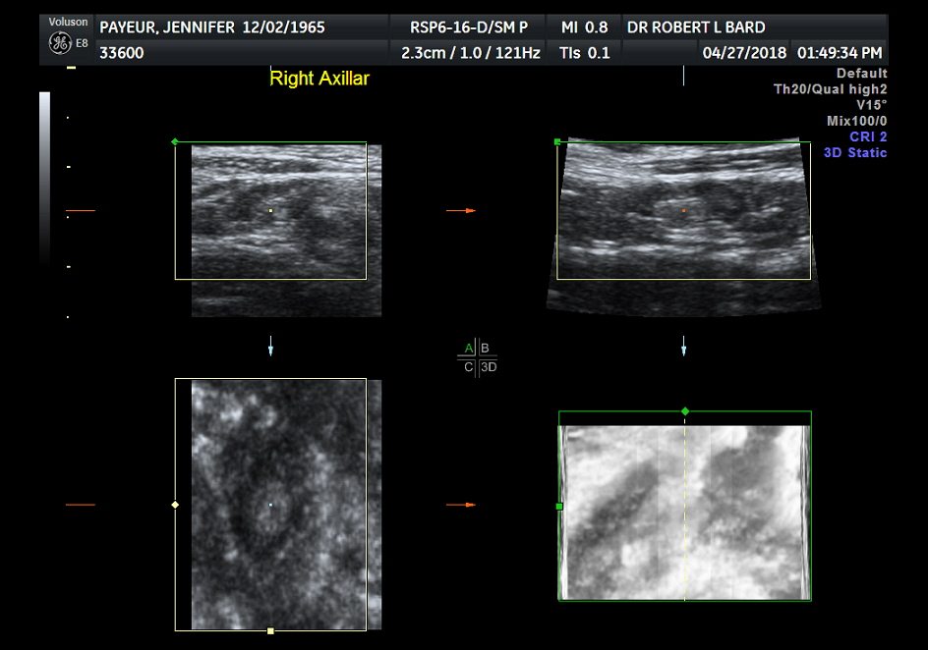
False + Pet Scan
4D real time sonogram
Silicone Granuloma From Cosmetic Surgery

Slide 28
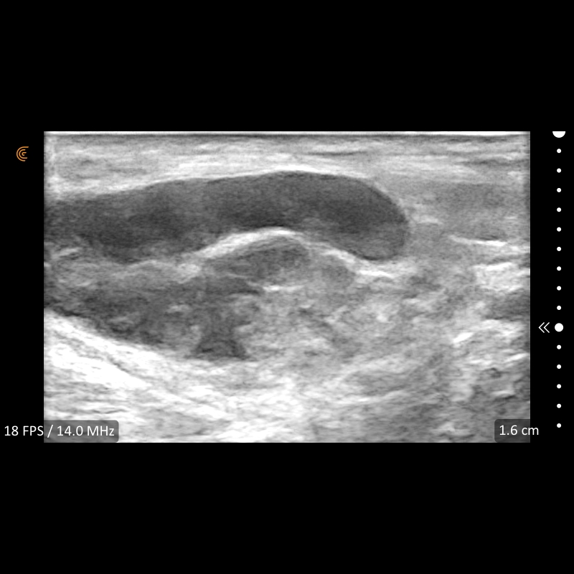
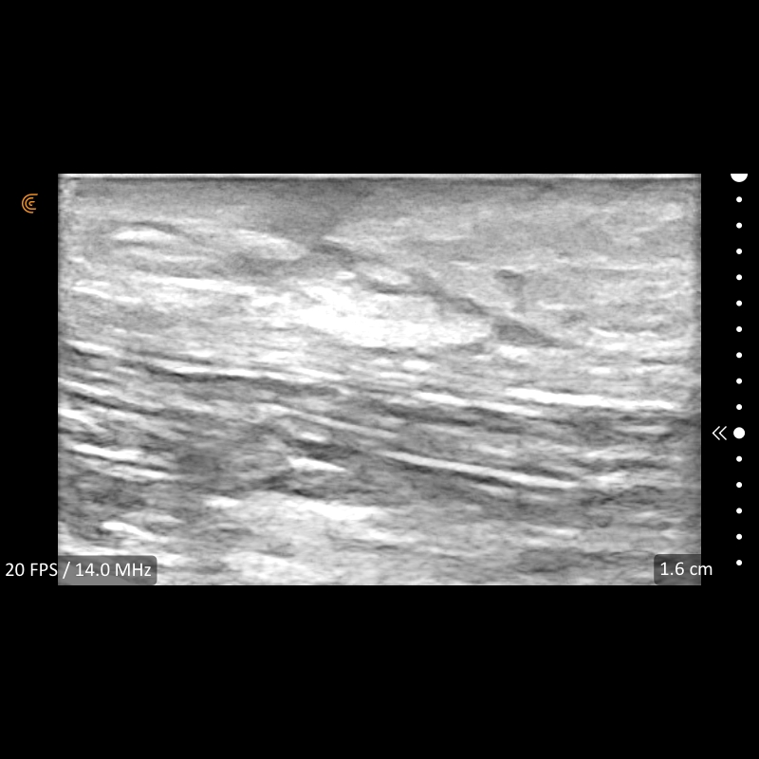
Lymphadenitis Scar
FILLER
FIBROSIS
NODAL INFLAMMATION
Vaccine or Filler Reaction = False + PET/CT Scan
Male Cosmetic Surgery Increasing

Slide 29
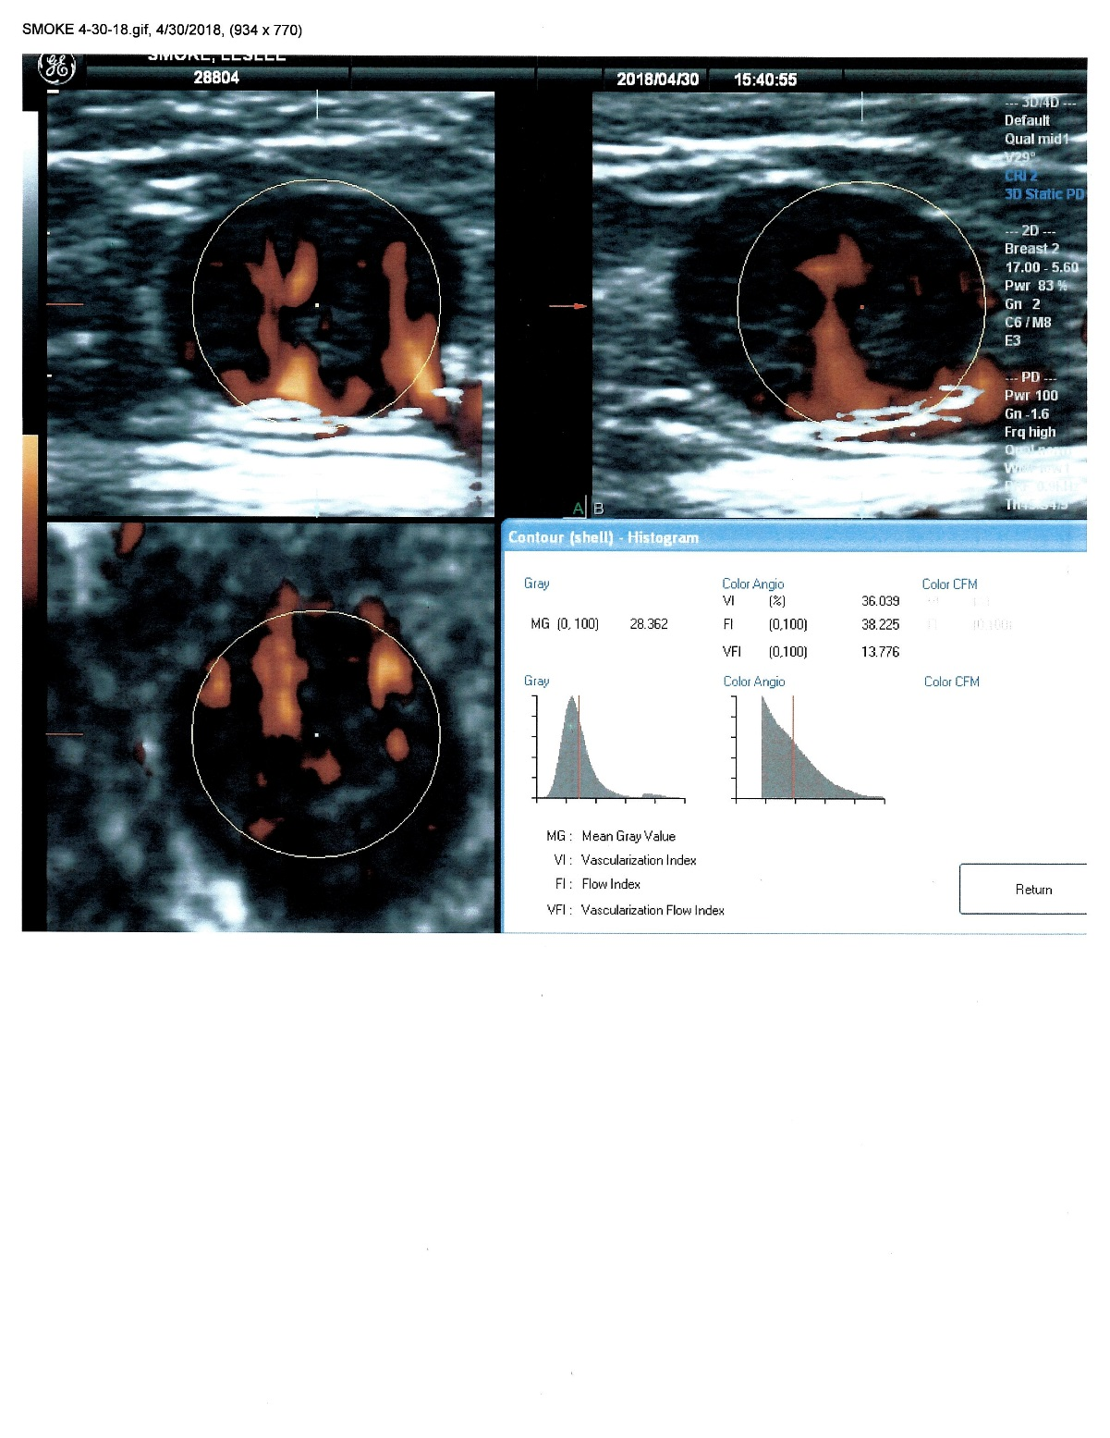
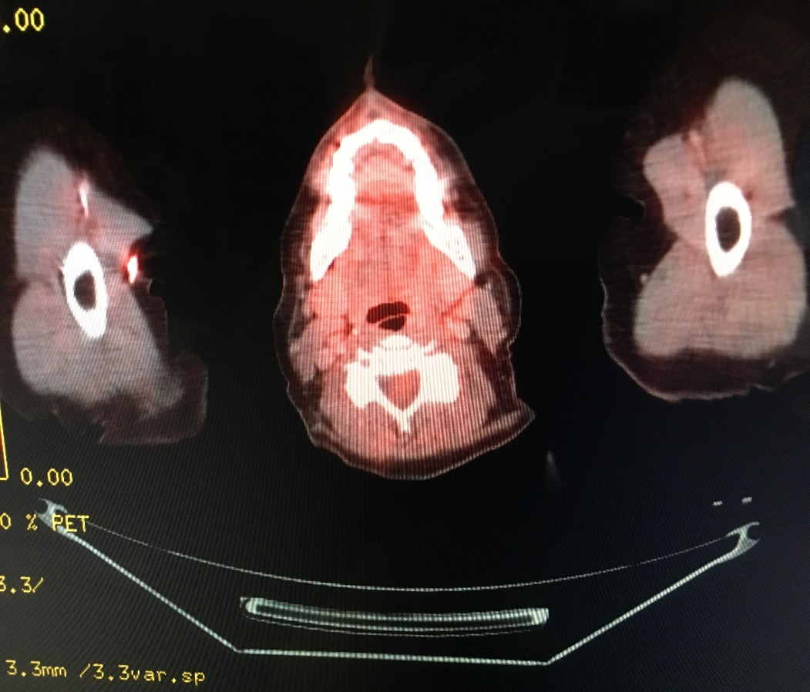
+ PET SCAN - Axilla Node
3 axillary nodes palpated one positive node 36% vessel density=highly aggressive

Slide 30
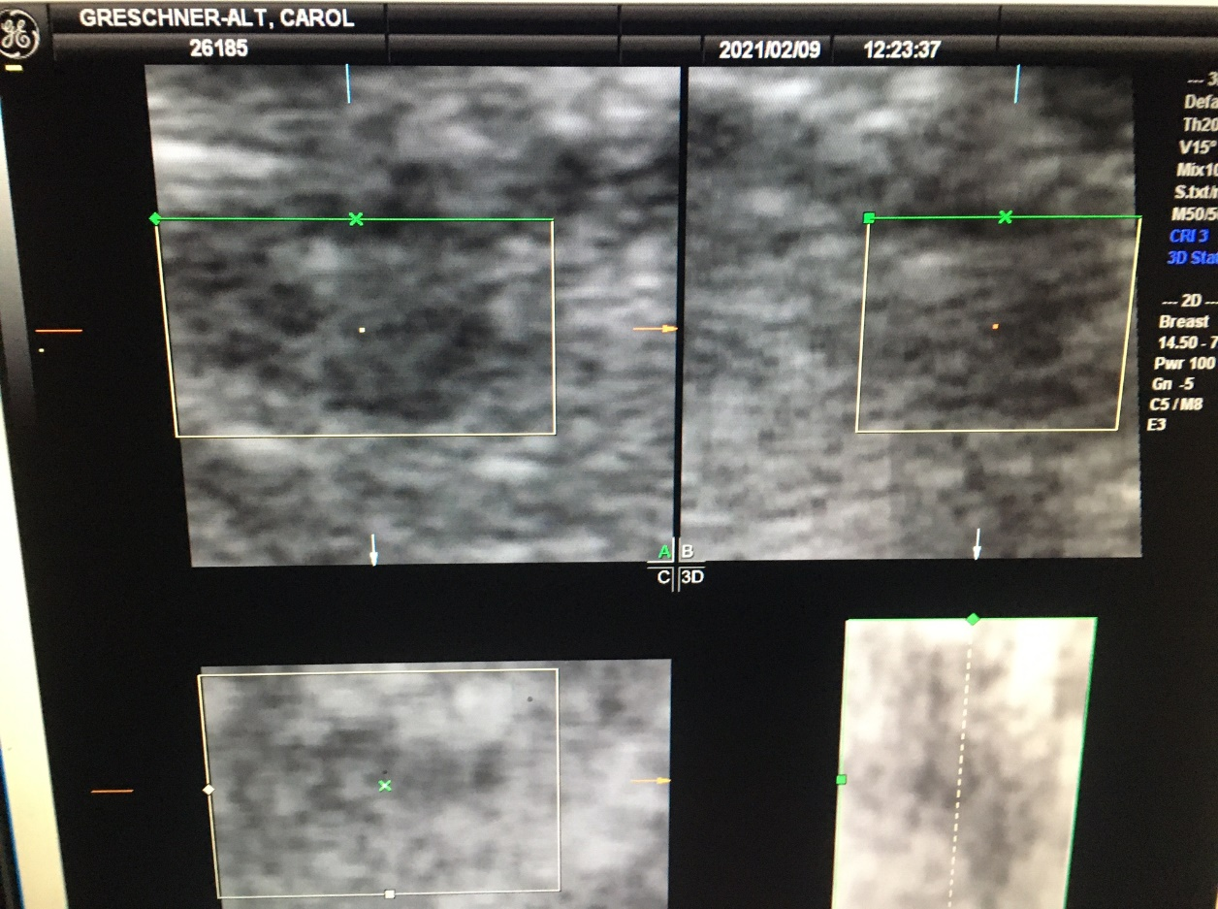
R Axillary Node Missed on PET/CT
Lesion 3mm

Slide 31
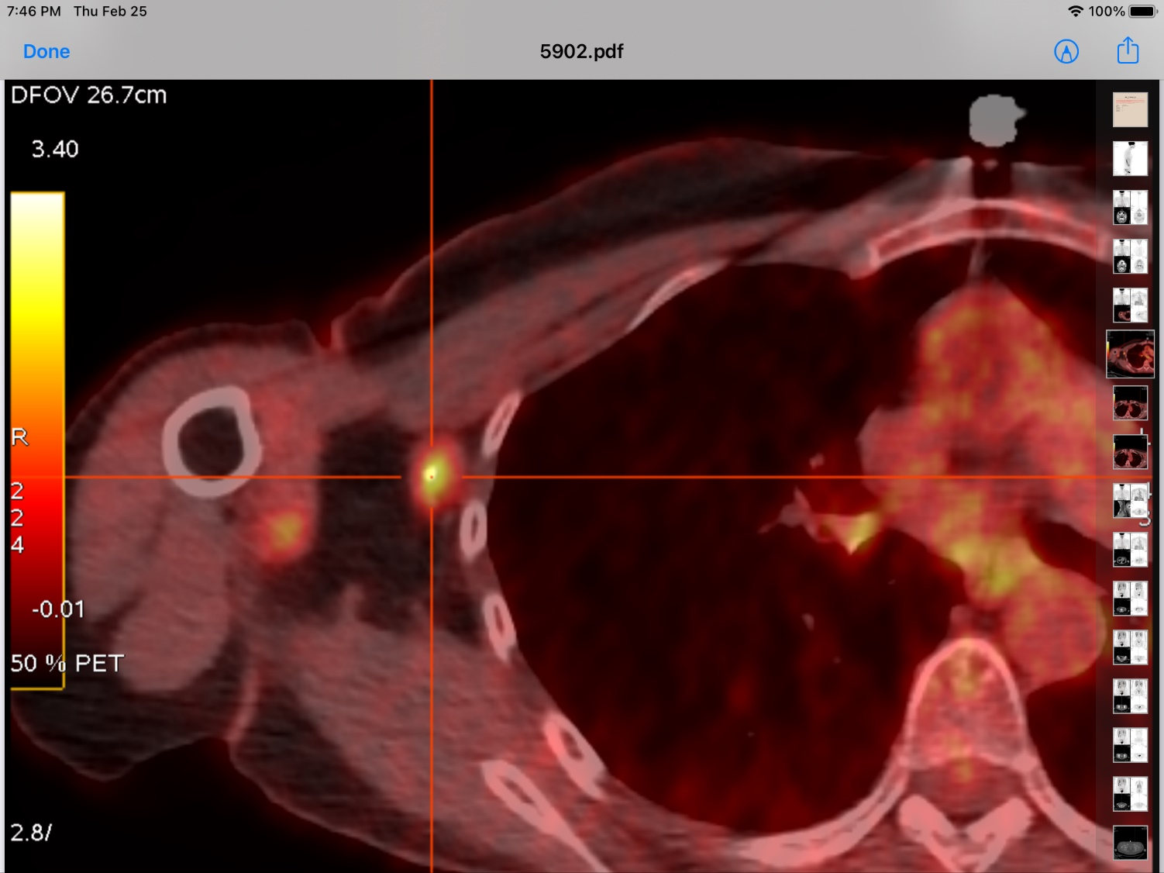
DIGITAL PET/CT Nodal Cancer

Slide 32
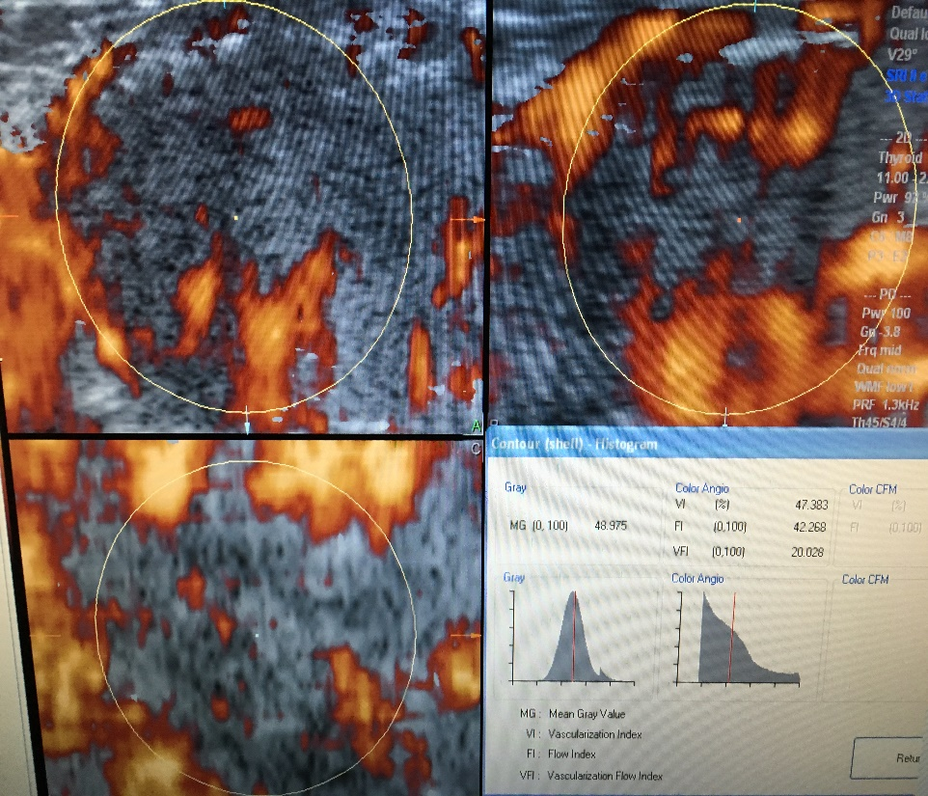
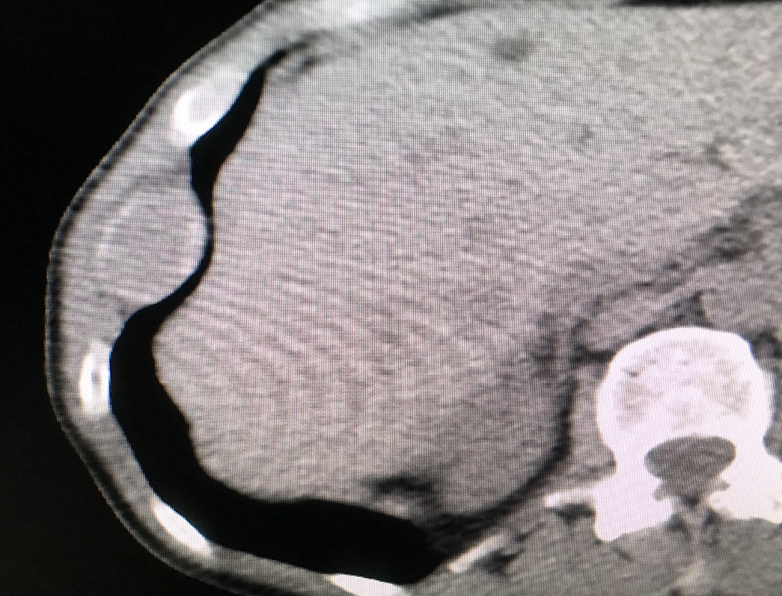
Metastatic Focus to 8th rib
3-D HISTOGRAM ANALYSIS SHOW HIGH GRADE TUMOR VI=47%

Slide 33
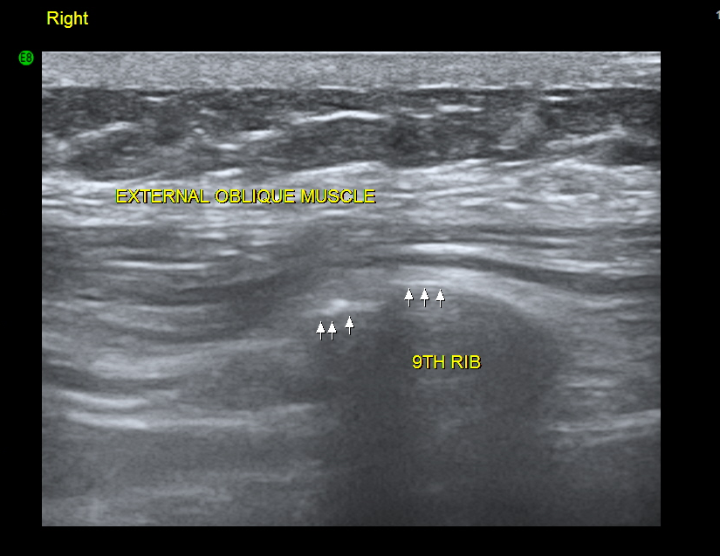
Spiral FX 9TH Rib

Slide 34
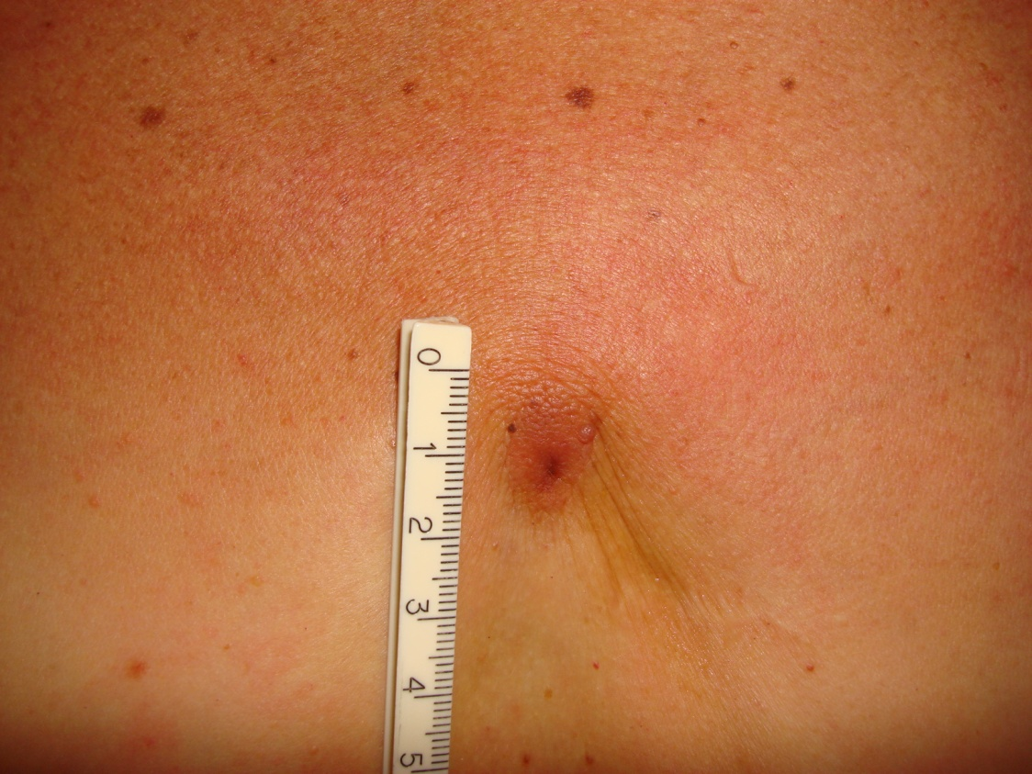
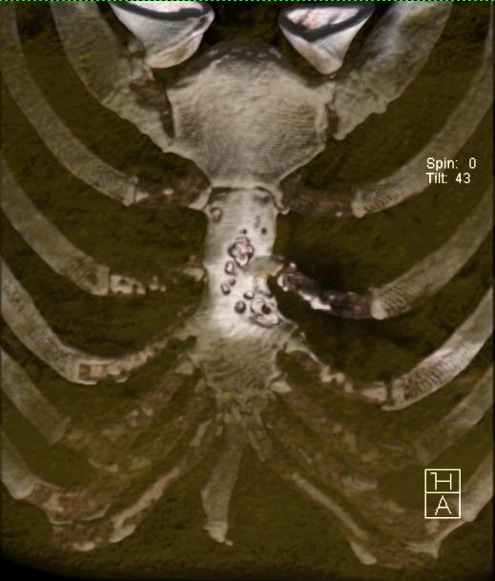
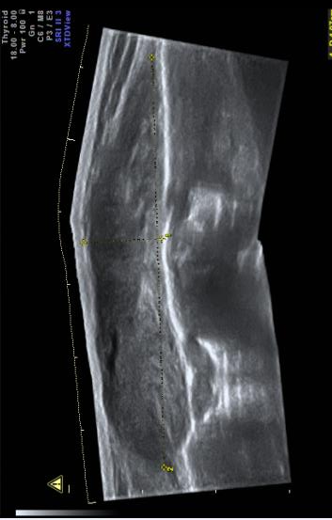
DERMAL POSTOP LESION diagnosed as keloid
Sternal bony erosion due to invasive BCC
Dermal lesion is 1cm subcut mass 3x6cm
STERNUM
STERNUM
(Side View)
? Keloid
SKIN
Mass
erosion
Postop
Site

Slide 35
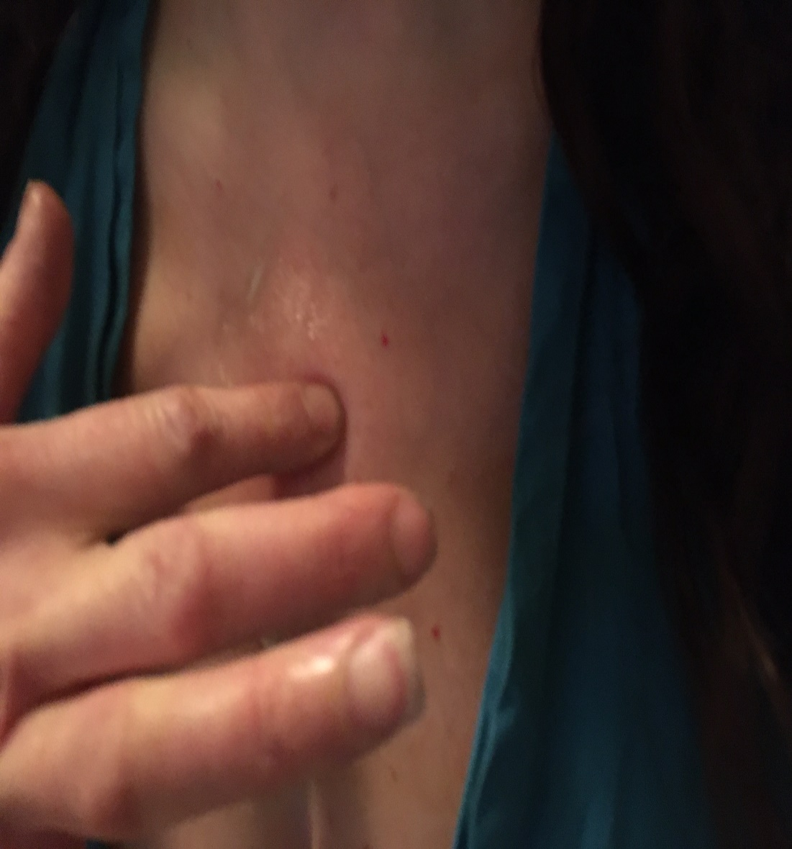
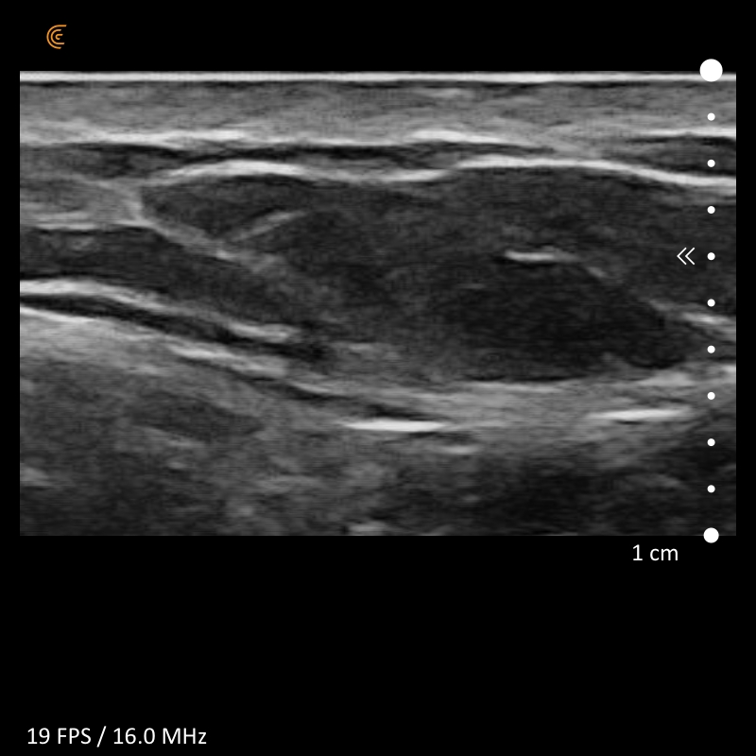
Presternal Lipoma
LIPOMA
Sternum

Slide 36
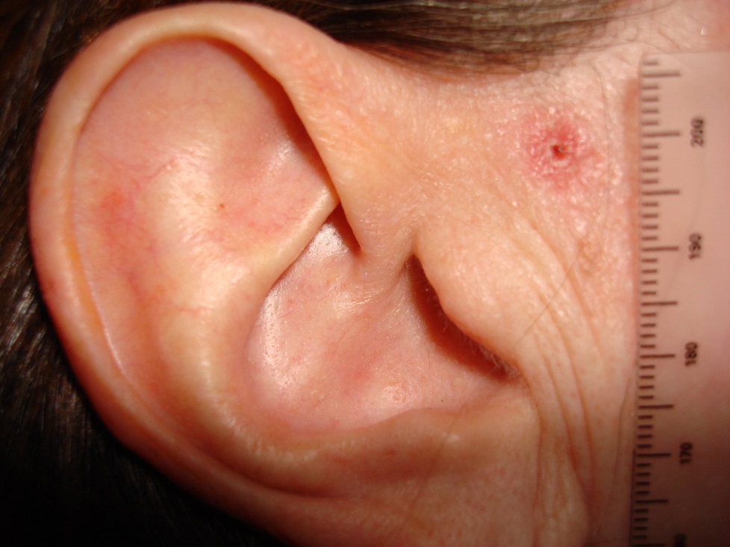
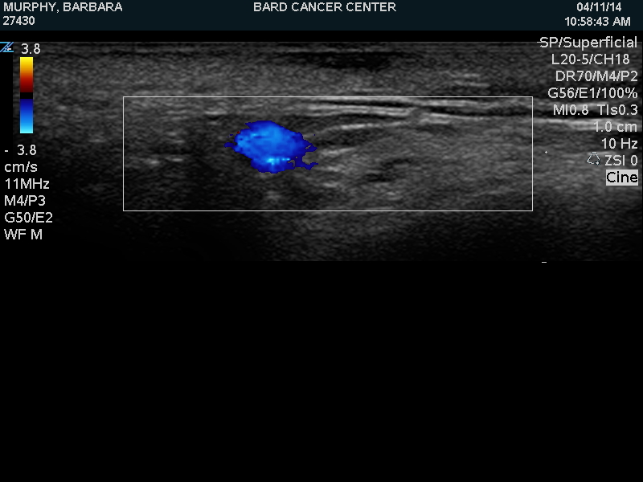
BCC 3mm from facial nerve
Depth
2.1 mm
Facial Nerve
FACIAL VEIN

Slide 37
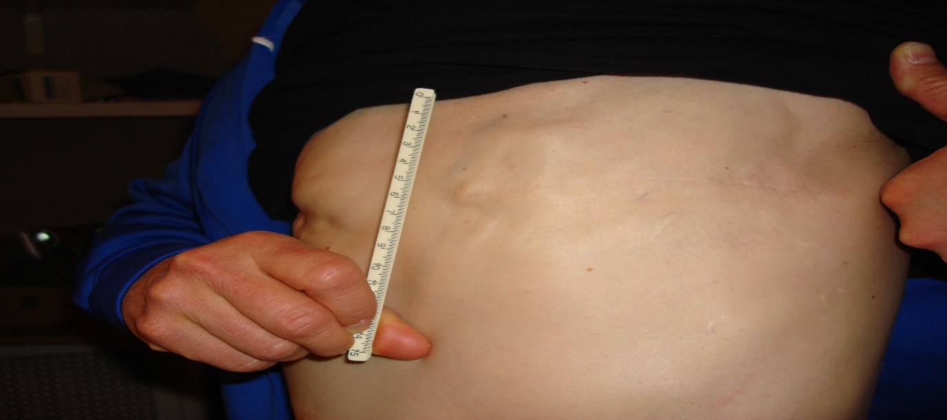
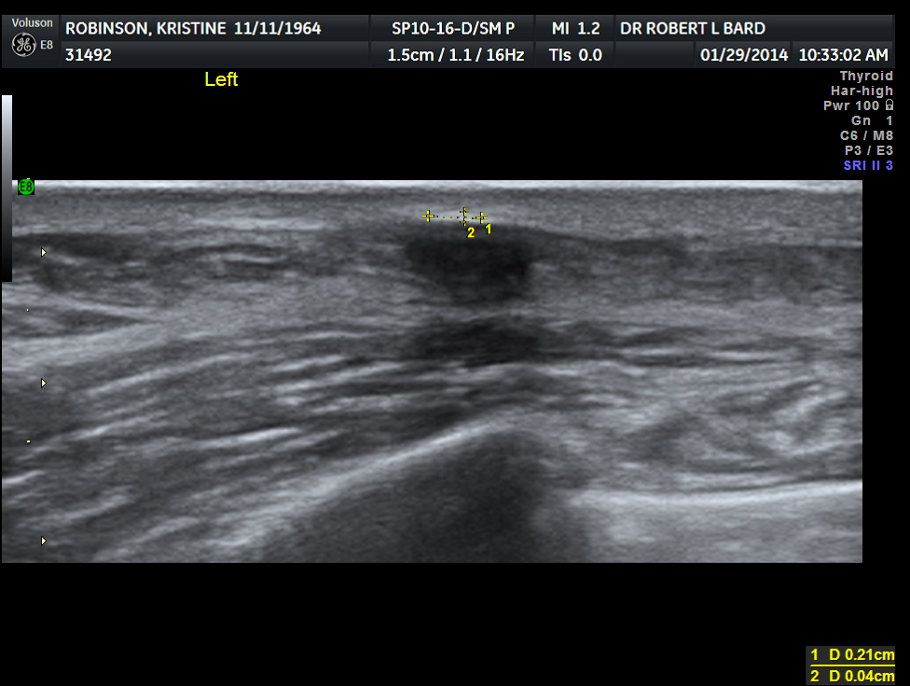
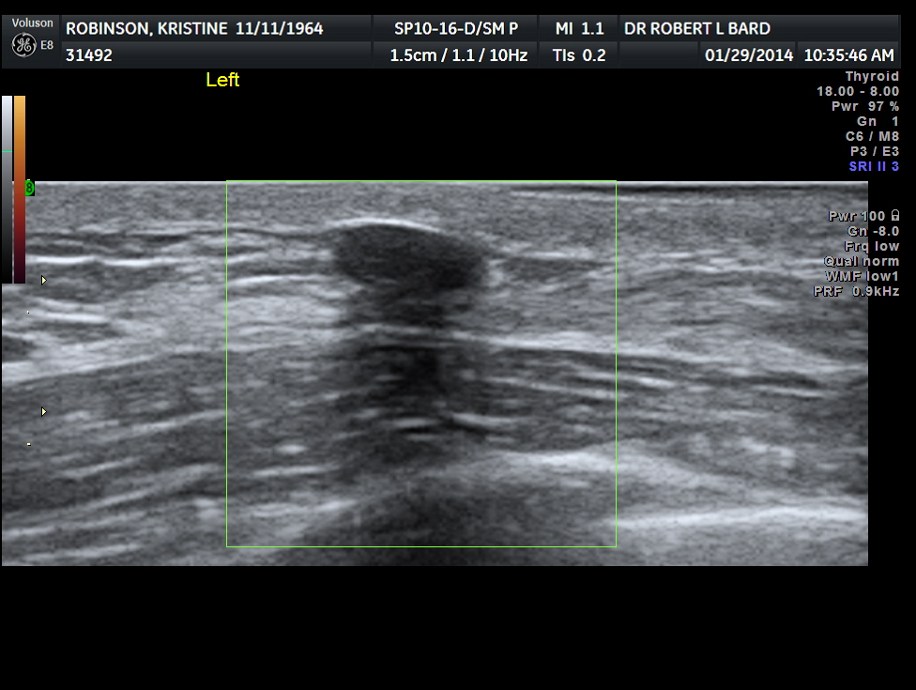
Bilateral Mastectomy / Tumor Recurrences?
suture
calcium
granuloma
fat
necrosis
PECTORAL PECTORAL MUSCLE
RIB RIB

Slide 38
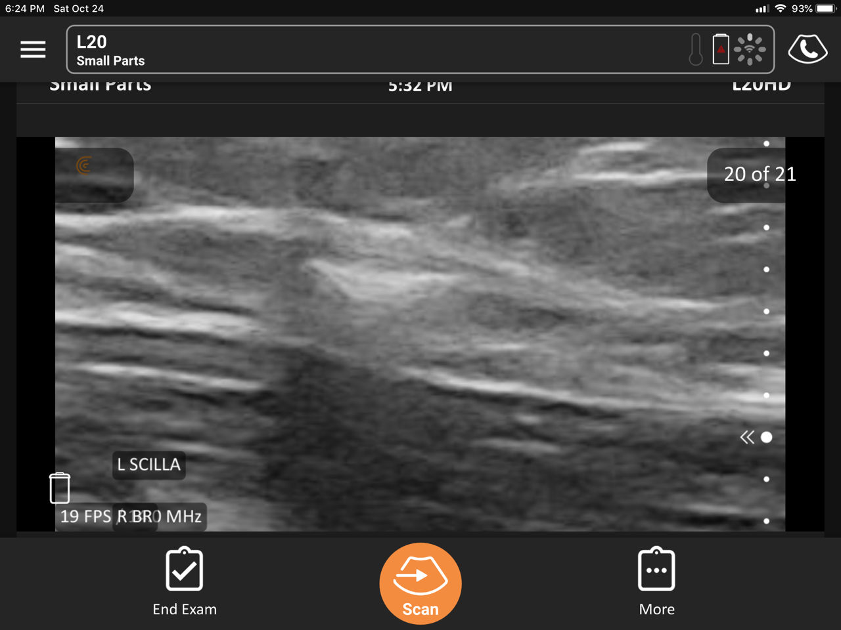
Axilla Suture Fibrosis - Tender
skin
PECTORAL MUSCLE

Slide 39


4mm Deep Scar Pre-treatment
Dermal scan mid neck – Elastography (blue = hard tissue)

Slide 40

Postop Scar - Implant
DERMIS SCAR
Fibrosis
Double
Lumen
Implant

Slide 41

Dense Breast Scanning

Slide 42

6mm Inflammatory CA - Left

Slide 43


Inflammatory Breast CA note – 0.1mm epidermis dilated lymphatics in 5 mm dermis

Slide 44



Breast Inflammation?
(L) inflammatory ca (R) allergic reaction
Dermis 1.2 mm
DERMAL DEPTH 5.2 MM

Slide 45


Radiation Edema
Photosensitivity increased by oncotherapies and radiation

Slide 46

ABUS 3-D Probe

Slide 47

G.E. Automated Breast US
Benign node 12mm

Slide 48

ABUS Nodal Metastasis node 9x19 mm – non palpable

Slide 49

ABUS Lipoma

Slide 50

Nipple and skin optical imaging for laser tumor margins

Slide 51


Benign Gynecomastia
PECTORAL
MUSCLE
LUNG
European male with Covid-19 Note pleural thickening

Slide 52

Uveal Melanoma
retina
Non Invasive 3-D Sonogram Diagnosis
Tumor: Size, Aggression and Stage Documented
Bard Diagnostics, New York City

Slide 53



Ovarian Subdermal Met
Dermal invasion (top)-high grade (deep)

Slide 54


Slide 55



“STARRY NIGHT” Uranium Toxins
Intradermal Metallic Deposits Quantified
On 4-D Ultrasound Histogram Display
4-D DERMAL SCAN
3 mm of intradermal tissue on back

Slide 56

2018 I.C.I.S. Conference

Slide 57

Contrast US in nodes

Slide 58
Metastatic melanoma treated with a combination :
HDAC inhibitor + radiotherapy :
Goal of DCE-US : to confirm the anti-angiogenic effect of radiotherapy performed 1 week after the beginning of HDAC
CEUS=CONTRAST ENHANCED
ULTRASOUND and
CT-scan at Baseline
COURTESY
DR NATHALIE LASSAU

Slide 59
DAY 42
COMPLETE TRANSFORMATION
INTO A CYST WITH DECREASED
VOLUME AT SIX WEEKS
Pseudo-progression verified By Doppler study

Slide 60


Slide 61


Slide 62

COVID Nodal Diagnostics

Slide 63


Slide 64

Metastatic Melanoma
(missed micrometastatses)
Tumor has spread even before biopsy is performed

Slide 65


Slide 66


Slide 67


Slide 68


Slide 69


Slide 70


Scar Carcinoma

Slide 71


Slide 72


Slide 73


Vascular Metastasis
(on biologic therapy)
Clinical Exam = Lipoma Subclavicular Location
Pathology = follicular Lymphoma “Florid Type”
Note: vascular connecting vessel from
subclavian artery

Slide 74

Trichilemmal Cyst?

Slide 75

AVM with anterior clot
thrombus
Pseudoaneurysm of temporal artery not palpable

Slide 76

Female, 33 y
Thickened left axillary fold
Case courtesy Dr. F. Alfageme Madrid Pres, DERMUS

Slide 77
RIGHT
LEFT

Slide 78
RIGHT

Slide 79
LEFT

Slide 80
LEFT

Slide 81
EOSINPHILIC FASCIITIS: TREATMENT
PO STEROIDS + METHOTREXATE 3 months

Slide 82


Slide 83
Updated from the original presentation @ The 109TH ANNUAL MEETING ARRS BOSTON (2009)
3-Dimensional Doppler Sonography
and DCE-MRI of Recurrent Prostate
Cancer Following HIFU Therapy
ROBERT L. BARD, MD
Director - Biofoundation For Angiogenesis / New York, NY USA
JELLE O. BARENTSZ, MD
Vice Chair of Radiology Research / UMC St Raboud, The Netherlands

